Slide 1
CEZEN-PBX
19-03-2025

Slide 2
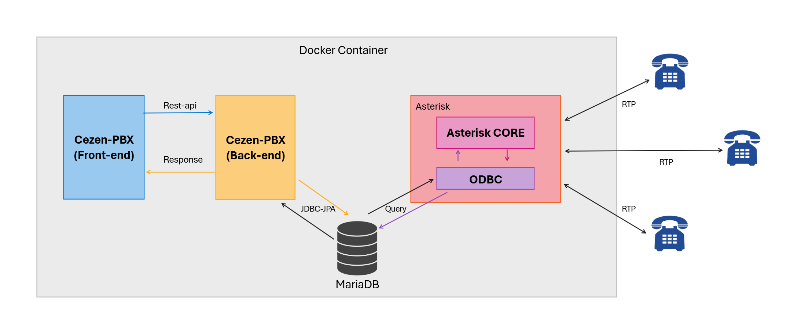
agenda

Slide 3
Updates
Installed andrius/Asterisk In docker running on a physical Ubuntu machine
Bridge the container with the host machine for reliability and speed
Deployed the docker container on the ubuntu server and successfully called two phones with no RTP issues
Set up ODBC to switch from a file based config into a DB based one
List out features

Slide 4
Thank you

